Slide 1
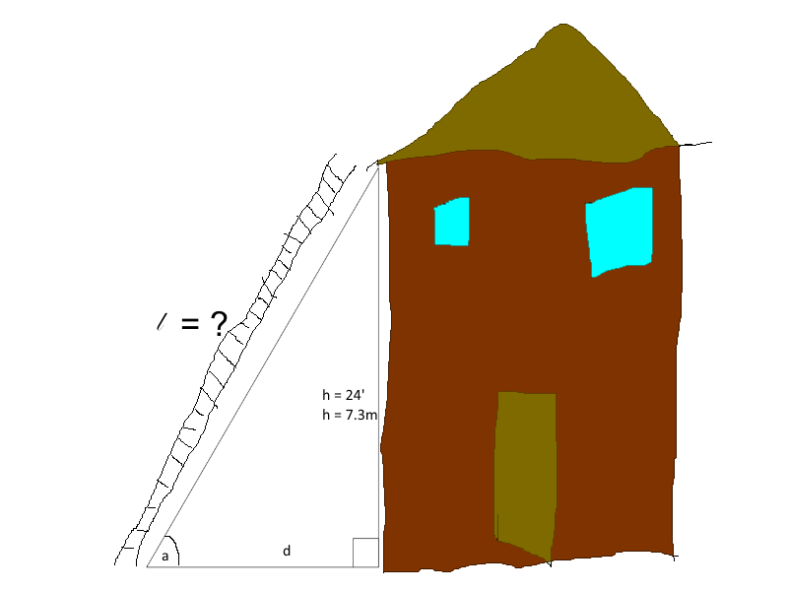
Building High Quality Inclusive Early Childhood Programs from the Ground Up
Linda Warren, Early Childhood Associates, Inc (ECA)
May 23, 2019

Slide 2
A Picture is Worth 1,000 Words!
Choose a picture that best represents your feelings about how your district currently supports the needs of young children with disabilities?
Share your picture with others at your table. Identify your reasons for selecting your picture.

Slide 3
Building High Quality Inclusive Early Childhood Programs from the Ground Up
Guiding Policies and Practices on Inclusion
Assessment and Eligibility Processes
Program Quality Rating Frameworks
Inclusive Practices to Support All Children
This Photo by Unknown Author is licensed under CC BY-SA

Slide 4
Guiding Policies and Practices
DHHS and ED Federal Policy Statement
Early Childhood OSEP Outcomes
MA EC SPED Strategic Plan
DEC Recommended Practices
DEC/NAEYC Joint Position Statement
This Photo by Unknown Author is licensed under CC BY-SA

Slide 5
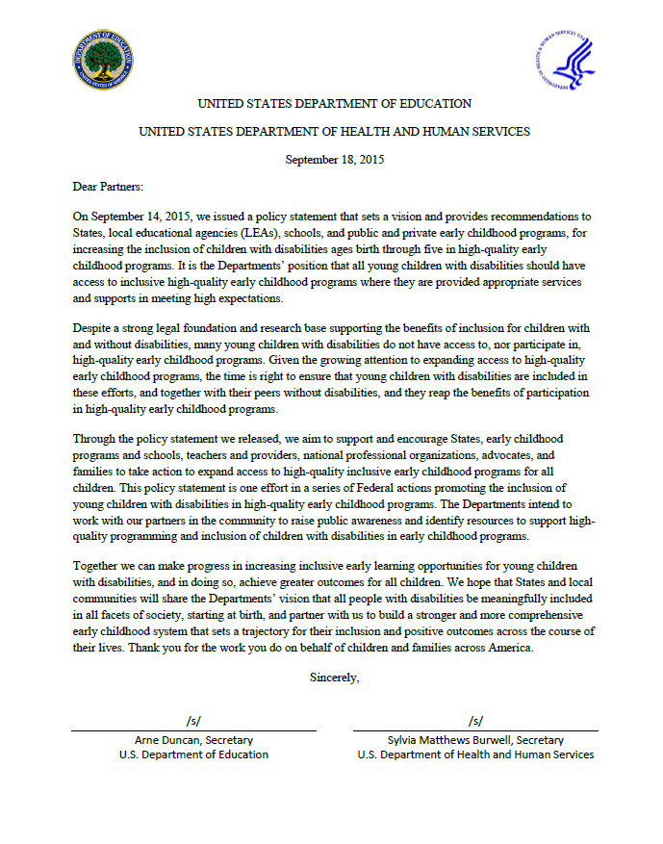
Federal Policy Statement
Federal Policy Statement
Inclusion of Children with Disabilities in Early Childhood Programs
www.ed.gov/early-learning
www.acf.hhs.gov/programs/ecd
Notes:
The joint federal policy statement on inclusion released by the US Departments of Education and Health & Human Services in 2015 digs deeply into defining what is meant by participation in inclusive programs and defines the challenges and offers resources for addressing these challenges. We know for example that approximately 45% of children with disabilities in this country are in inclusive settings—55% are in separate programs and this percentage has not changed in the past decade. Now why is this happening? There are a number of reasons but a primary one is that we do not have enough of high quality early childhood programs to include children with the adaptations needed to support them or the staff expertise to implement these programs effectively. And this is a problem that I venture to say permeates most of your programs for young children. We simply do not have enough space in public schools to accommodate the inclusion programs we need. What is the answer? Well one approach is to build up quality and capacity in the private programs operating in our communities. The need to be part of the conversation about meeting the needs of children with disabilities, they need support and opportunities to be trained. If we address this now, we will have a significant return on investment down the road.

Slide 6
OSEP Early Childhood Outcomes
Positive social-emotional skills (including social relationships)
Acquisition and use of knowledge and skills (including early language/communication and early literacy)
Use of appropriate behaviors to meet their needs.

Slide 7
Massachusetts

Slide 8
2014 DEC Recommended Practices
http://www.dec-sped.org/recommendedpractices

Slide 9
DEC/NAEYC Joint Position Statement on Inclusion
Access
Participation
Benefits
This Photo by Unknown Author is licensed under CC BY

Slide 10
Federal Policy Takeaways
The first placement options for young children with disabilities are inclusive settings
We need formal agreements and strong collaboration with EC settings outside the public schools
There is a strong movement to turn the field of education into a family centered-versus- child centered system.
Assessment must target both the characteristics of the child and the characteristics of the classroom environment.
Children with disabilities do not need to be ready to be included; rather programs need to be “ready” to support all children.
We need to train specialists how to use evidence-based consultation and effective coaching models.
We need to provide teachers with the coaching necessary to adapt curriculum, activities and experiences and ensure therapists are knowledgeable of these components.

Slide 11
Assessment
Eligibility
Placement

Slide 12
Authentic Assessments
Imagine being put in a room with people you do not know; shown materials you may have never interacted with; and asked questions about things you are not familiar with; possibly in a language that you do not understand…
Could this be one reason we are over-identifying young children for special education services?

Slide 13
Rethinking the Assessment Process
Create
Create an Assessment Team to conduct child assessments
Use
Use OSEP Child Outcomes to frame assessment and IEP development
Select
Select an Assessment tool that aligns with OSEP Outcomes
Launch
Launch the Process with observations of children with peers in the context typical early childhood routines

Slide 14
Assessments Aligned with Child Outcomes
Adaptive Behavior Assessment System, Third Edition (ABAS-3)
Brigance Diagnostic Inventory of Early Development III (IED-III)
Desired Results Developmental Profile (2015)
Developmental Assessment of Young Children (DAYC-2)
Early Learning Scale

Slide 15
Child-Focused Assessments
Natural observations of ongoing child behavior in everyday settings and routines vs. contrived arrangements
Reliance on informed caregivers (teachers, parents, team) to collect convergent, multi-source data across settings
Curriculum-based measures linked to program goals, content, standards, & expected outcomes
Universal design; equitable assessment content and methods.

Slide 16
Assessments Targeting the Child and the Learning Environment
Characteristics of the Child
Characteristics of the Environment

Slide 17
Program Quality Rating Frameworks
Early Childhood Environment Assessment
Classroom Assessment Scoring System
Inclusive Classroom Profile

Slide 18
Early Childhood Environment Assessment
Space and Furnishings
Personal Care Routines
Language-Reasoning
Activities
Interactions
Program Structure
Parents and Staff

Slide 19
Early Childhood Interactions Assessment
Social-Emotional Domain
Classroom Organization
Instructional Support

Slide 20
Inclusive Classroom Profile (ICP)
Adaptations of Space, Materials, and Equipment
Adult Involvement in Peer Interactions
Adults' Guidance on Free Choice Activities and Play
Conflict Resolution
Adult/Child Relationships
Communication Support
Adaptation of Group Activities
Transitions between Activities
Feedback
Family-Professional Partnerships
Monitoring Children's Learning

Slide 21
Practices

Slide 22
Practices that support young children with a range of disabilities...
Use classroom routines and activity matrices
Use evidence based curriculum
Use progress monitoring tool
Provide tiered and differentiated instruction
Use specialists to support classroom teachers using TA strategies and co-teaching models
This Photo by Unknown Author is licensed under CC BY-SA-NC

Slide 23
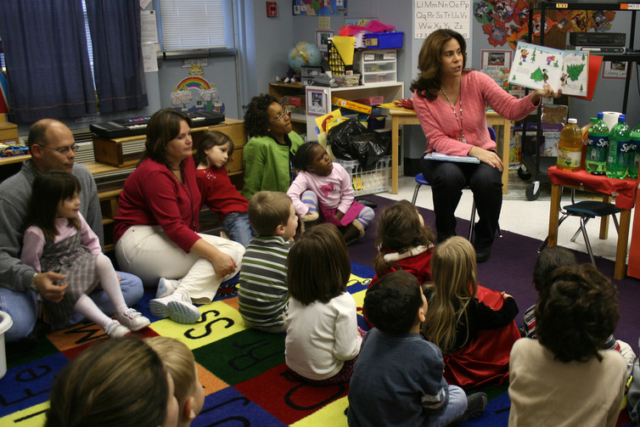
Story of Perla/Circle Time
4.5 year old girl with autism who attends an inclusive public school classroom
Uses 2-4 word phrases to communicate
Follows simple verbal directions during most routines
Imitates others when prompted
Rarely interacts with peers
Uses picture schedule
Participation in circle time is inconsistent-cries during transition, avoids peers, sits on edge of carpet, disrupts with loud vocalizations or escapes the area, engages in stereotypic disruptive behaviors in other parts of the room

Slide 24
Access, Participation and Benefits
Issue--Circle time problematic for children with autism- Why?
Challenge--Over 90% of preschool programs have circle time daily-What does it look like? Require?
Benefit--Circle time may be beneficial for children with autism- In what ways?
Adaptations-Circle time can be adapted to address social and communication needs- How?

Slide 25
Assessing Functional Needs during Circle Time
Child’s Name: Perla | Can the child do what peers do? |  |  | Team Concern? |  |  | Comments
Skills necessary for: Circle Time | Always | Sometimes | Not Yet
Social Interactions |  |  | X |  | X |  | Circle might be a good time to teach her social interactions goals from her IEP.
Communication |  | X |  |  | X |  | Use circle for generalization of communication goals.
Mobility-independent movement to circle | X
Using fingers, hand and arms in song |  | X |  |  |  |  | She has the skills but does not always want to participate.
Following verbal directions |  |  | X |  | X |  | Use circle for generalization of this IEP goal.
Attending to the teacher |  |  | X |  | X |  | Circle might be a good time to teach.

Slide 26
Assessing Expectations during Circle Time
Child’s Name: Perla | Does the child do what peers do? |  |  | Team Concern? |  |  | Comments
Circle Time Activity | Always | Sometimes | Not Yet
Transition to circle |  |  | X |  | X |  | A picture schedule might help with her transition
Good morning songs | X
Giving roles | X
Calendar review |  | X |  |  | X |  | She often escapes circle right be for calendar but stays when she is the calendar helper.
Movement activity |  | X |  |  | X |  | She always participates in this and often asks for it outside of circle.
Transition to hand washing | X |  |  |  |  |  | She loves washing hand because she likes the foamy soap.

Slide 27
Adaptations For Circle for Children with Autism
Adaptation Level
Adaptation Types
Least Intrusive
Most Intrusive
Environmental
Materials
Activities
Expectations
Adult or Peer Assistance

Slide 28
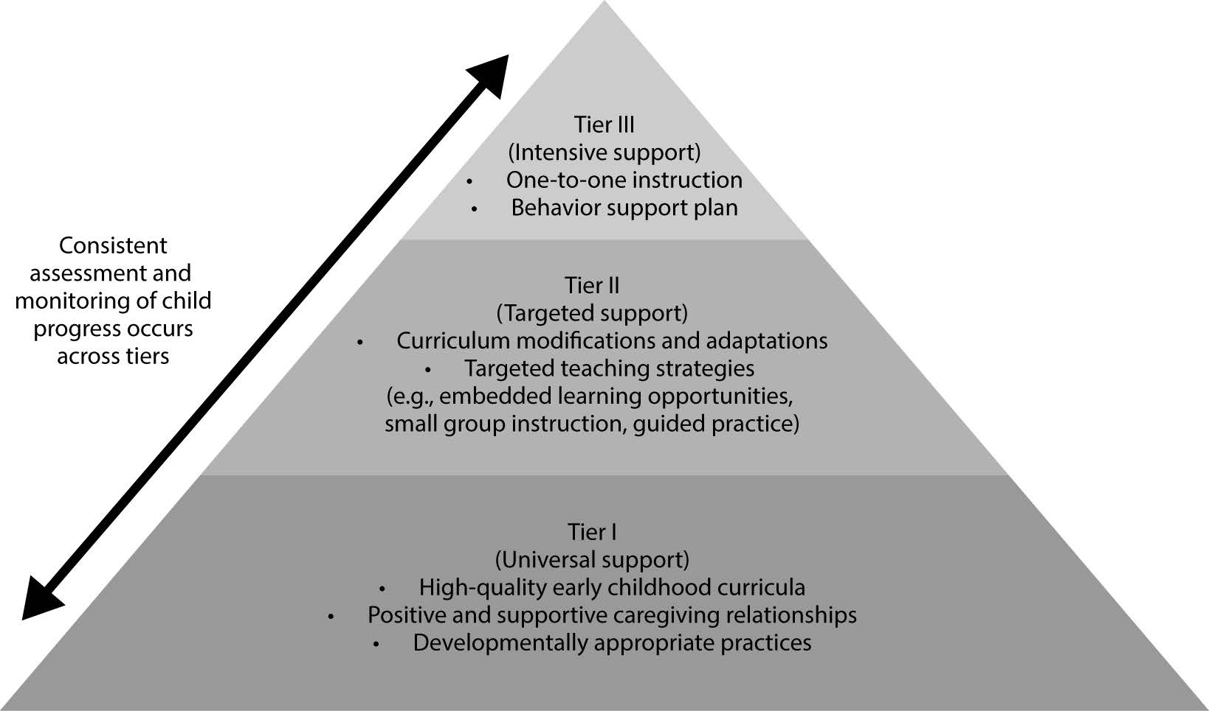
Response to Intervention in Early Childhood

Slide 29
Specialists as Coaches
THE COACHING PROCESS
Observing
Feedback
Reflection
THE COACHING STRATEGIES
Modeling
Demonstration
Co-teaching

Slide 30
Supporting Early Childhood Educators
Introduce
Introduce the practice
Model or demonstrate
Model or demonstrate the use of the practice
Engage
Engage with teachers in the use of the practice
Facilitate
Facilitate teachers' self-evaluation of their experience using the practice
Facilitate
Facilitate teachers' reflection on their understanding of the practice
Provide
Provide ongoing supports and learning opportunities to teachers to perfect their use of the practice

Slide 31
Reflection
Some ideas that square with my thinking…
A thought going around in
my head…
Three points I would like to remember…

Slide 32
Q & A

Slide 33
Thank You!

